Slide 1



Pastoral Strategy
Webinar 3rd March 2026
Diocese of
Hexham & Newcastle
Welcome

Slide 2

Opening Prayer
Heavenly Father,
We thank you for your calling, your guidance,
and your love that entrusts us with the mission
of your Church in our diocese.
Unite us as one family of faith, attentive to your Spirit
and supporting one another with care and compassion.
As we begin this time of discernment, bless and guide us,
that it may be a spiritual journey of listening and honesty
that moves us to action.
Help us to reflect deeply on our mission and resources,
to face reality with courage,
and to choose what will allow our communities to flourish
for generations to come.
Continued...
1

Slide 3
Opening Prayer
Keep us faithful to walking together,
seeking truth with hope,
and responding to your call with generosity.
Form us as missionary disciples,
ready to serve and proclaim your Gospel.
Give us wisdom to make decisions that strengthen worship,
service, teaching, and community.
May all we do be rooted in prayer and guided by your Spirit,
so that we may steward our resources faithfully and build a
Church that is vibrant and welcoming.
We entrust our Diocese to the prayers of Our Blessed Lady Immaculate,
and to the intercession of the saints who have gone before us.
Through Christ our Lord.
Amen.
1

Slide 4

We say together...
Come Holy Spirit,
fill the hearts of your faithful,
enkindle in us the fire of your love,
send forth your Spirit that we shall be created
and You will renew the face of the earth.
Amen.
1

Slide 5

Introduction and Background
3

Slide 6
Diocesan Vision and Mission
What is the Lord calling us to be?
At Pentecost 2024, the Diocese launched a consultation on the proposed Diocesan Mission and Values.
Parishes and Partnerships were encouraged to send responses to the Bishop by October 2025.
What is the Lord calling us to do?
The Diocesan Vision documents were then refined, taking into account feedback.
4

Slide 7
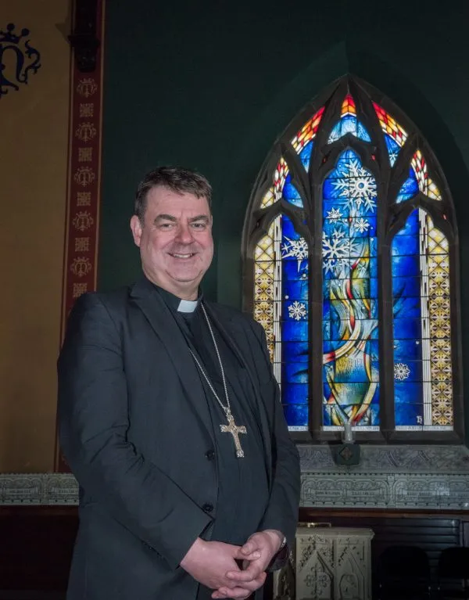
Diocesan Vision and Mission
Bishop Stephen’s Pastoral Letter at the beginning of Advent 2025 focussed on the hopes and challenges facing our communities.
He reminded us we are here for Mission.
The Church exists for Mission – to bring Christ to the world.

Slide 8
Diocesan Vision and Mission
What is the Lord calling us to be?
A flourishing Diocese alive in the Holy Spirit, where people encounter Jesus Christ,
where we live with justice and compassion, grow as one family of faith,
and are formed and sent as missionary disciples to build God’s Kingdom.
6

Slide 9
What is the Lord calling us to do?
The Diocesan Vision is centred on four Commitments:
Walk with Jesus and enable encounters with Him.
Live Justly and care for our common home.
Grow as one Diocesan family.
Be formed and developed by Christ for Mission.
Notes:
Pastoral Priorities
Walking with Jesus and Enabling Encounters with Him
Renewing sacramental preparation as a journey of accompaniment and encounter.
Deepening our communities as places of welcome, safety and belonging – sharing God’s love with all.
Creating opportunities to walk with Christ throughout our entire lives.
Living Justly and Caring for Our Common Home
Stewarding our resources wisely — building a safe and sustainable future.
Being a Church that goes out to the margins.
Growing as One Diocesan Family
Growing as a synodal Church – learning to listen, discern and walk together.
Clergy: sustaining priestly ministry with care and collaboration.
Growing the gifts and vocations of the baptised.
Being Formed by Christ for Mission
Educating for Mission — forming hearts and minds in Christ,
Walking with our young people – forming faith, hope, and leadership.
Growing our discipleship through lifelong, Spirit-filled formation.

Slide 10
Diocese - where are we now: People
Mass attendance
Attendance has fallen dramatically over the past few decades
Between 1985 and 2024 it fell from 87,310 to 20,196 (77% reduction)
Mass attendance has climbed by around 2,000 since 2021 but hasn’t returned to pre pandemic levels

Slide 11
Diocese - where are we now: People
Number of Priests
Between 1951 and 2025 the number of Active Diocesan Priests fell from 368 to 61 – an 83% drop. The number of Retired Priests rose from 2 to 47 in the same period.
Currently 61 Active Diocesan Priests of which 54 are working in parishes.
Currently 33 Active overseas and/ visiting religious priests
In 2035 it is anticipated there will be 42 Active Diocesan Priests and 41 in retirement. (Assumes 22 retire and 3 newly ordained)

Slide 12
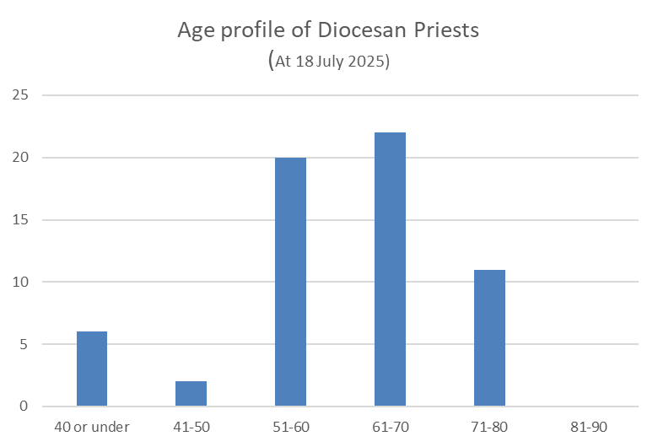
Diocese - where are we now: Age of Diocesan Priests
Age | Active Diocesan Priests | Retired Diocesan Priests
Over 90 | 0 | 8
86-90 | 0 | 11
81-85 | 0 | 10
76-80 | 4 | 13
71-75 | 7 | 3
66-70 | 8 | 1
61-65 | 14 | 1
56-60 | 13 | 0
51-55 | 7 | 0
46-50 | 0 | 0
41-45 | 2 | 0
36-40 | 4 | 0
31-35 | 1 | 0
30 and under | 1 | 0
Totals | 61 | 47
In 2025, only six Diocesan Priests were 40 or under
Over half were over 60
Wellbeing of our priests is a concern

Slide 13
Diocese – where are we now: Buildings
Average Mass Attendance per Church building
In 1985 Mass attendance was 87,310 across 189 churches (average of 462 parishioners per church)
In 2024 Mass attendance was 20,196 across 169 churches (average of 120 parishioners per church)
In 39 years mass attendance has fallen by 77% while number of churches has fallen by less than 11%

Slide 14
Diocese – where are we now: Buildings
Average Mass Attendance per Church building
In 1985 Mass attendance was 87,310 across 189 churches (average of 462 parishioners per church)
In 2024 Mass attendance was 20,196 across 169 churches (average of 120 parishioners per church)
In 39 years mass attendance has fallen by 77% while number of churches has fallen by less than 11%

Slide 15
Diocese - where are we now: QQ Maintenance Liability
  Quinquennial surveys of parish properties are undertaken every 5 years
  Current planned maintenance liability across all parish sites of £27,310,688 over next 5 years (£5,462,137 per annum)
  Compared against parish spend of £14,658,889 in last 5 years (£2,931,778 per annum)
  Parishes would need to spend £2,530,359 (86%) more on average per year for the next 5 years to attend to the maintenance liability
  Working capital (cash deposits less loans) for all parishes £28,257,658 (deposit – loans + current account)
  The additional annual expenditure needed to attend to the property planned maintenance liability would deplete reserves in 11 years
  A number of significant capital projects are already anticipated in the next 5 years
Property condition breakdown
Good | Fair | Poor
22.91% | 66.75% | 10.34%

Slide 16
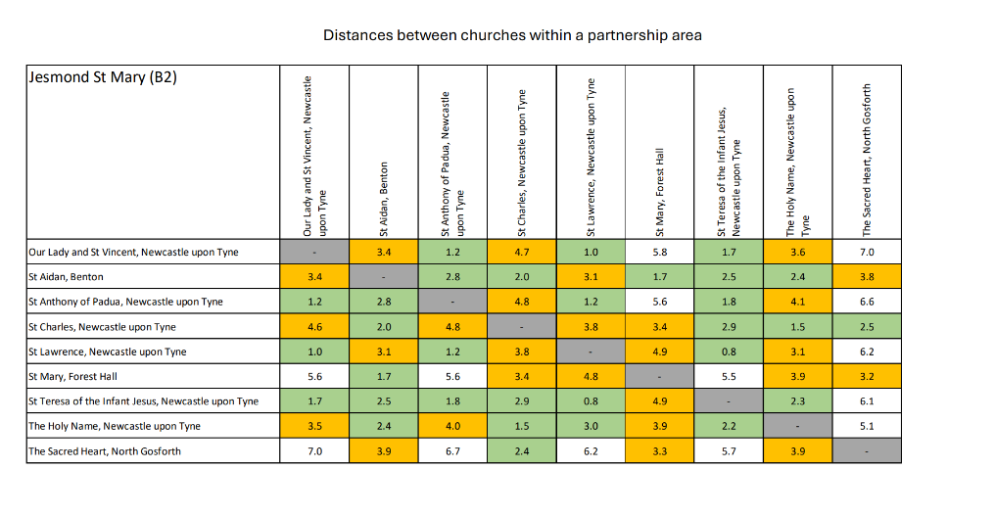
Distances between churches (sample report)

Slide 17
Diocesan Vision and Mission
Key Challenges:
  The increasing age profile of our priests. Many will soon retire. The Lord will provide sufficient priests, but we must pray for them.
  A significant decline in Mass attendance.
  The number of churches and buildings we have and the condition of them.
  The impact of all this on our mission.
Pastoral changes are necessary.
Pastoral change is part of being Church.
Pastoral change needs to be pastoral!
Synodality means that decisions must be shaped by local prayer, reflection, and dialogue. Final decisions rest with Bishop Stephen, but they must be informed by discernment at parish, local community/partnership, and deanery levels.
6

Slide 18
Diocesan Vision and Mission
To support this discernment, a Pastoral Srategy Mission Discernment Toolkit is now available for every parish.
It will help communities reflect on their mission, their resources, and the future.

Slide 19


What is the Parish being asked to do?

Slide 20
Parish Discernment (Spring 2026)
Each parish is asked to reflect honestly on its Mission and stewardship and to contribute to the wider diocesan plan by submitting a report – for which a template is provided.
The report is to be submitted to the Diocese by 23rd April 2026.
Where the Diocese holds relevant statistical information about the parish, this has been provided to you in a data pack.
The parish report is to be completed in dialogue with the community.

Slide 21

What the toolkit enables locally?
The toolkit provides shared language, data, and processes to support local discernment ​and enable a diocesan-wide synthesis
Part A – An introduction to the Discernment Toolkit.
Part B – The Diocesan Framework: Our pastoral priorities and principles for change.
Part C – The Diocesan Context: An overview of the communities which make up our Diocese and a personalised Parish data pack.
Part D – The Pastoral Planning Process: How this work fits into the overall planning process.
Part E - Local Mission Discernment: Guidance for parishes on how to reflect on the mission of the Church in our own area, focusing on how we serve, worship, teach and build community.
Part F – Stewardship Review: Guidance for parishes on reflecting on how parish resources – people, buildings, finances – serve the mission.
Part G – Guidance for parishes on summarising their conclusions.

Slide 22
Mission First
“To be baptised Christian is to have a vocation to build the Kingdom of God here and now. The focus must be mission. Not buildings, not structures, but mission. Buildings and structures serve mission, not the other way around.”
Bishop Stephen Wright
Pastoral letter 2nd Sunday of Lent 2025

Slide 23
Key thinking
The questions are prompts to enable a process towards the template
Invite wide participation but expect a core of people to carry this (P. Council)
Know you can submit something simple
Know you are ok to say “We don’t know”
Know it is ok to identify just one or two actions
Know you are not expected to solve structural diocesan challenges
This is a real Lenten challenge! Try and stay focused on Christ and focused on what your community can change e.g keep away from universal Church challenges
Pray!

Slide 24

Mission and Stewardship Discernment:
Mission – What are we called to do?
Parishes are asked to reflect on 4 essential tasks:
  WORSHIP: Celebrating the sacraments as places of encounter
  TEACH: Handing on the faith
  SERVE: Sharing Christ’s love in action
  COMMUNITY: Building a family of faith
In each case, listening to one another,
we should consider our Mission as a parish:
  What is going well?
  Where are the challenges?
Notes:
Purpose: Naming what the Holy Spirit is already doing — and where we are being invited to grow:
Discerning priorities together
Strengthening and sharing what is life-giving and leading to growth (Beacons)
Addressing pressures honestly and prayerfully
There are a set of questions built around Mission- What is our parish community here to do? (worship, teach, serve, community)
Stewardship – The sustainability of our people, finances and properties

Slide 25
Our Mission: To Worship
Celebrating the Sacraments
as places of encounter
What is going well?
What are the challenges?
Use the question prompts at Part E1 of the Pastoral Strategy Mission Discernment Toolkit to help guide your conversation.
Notes:
E1 WORSHIP — Celebrating the Sacraments as Places of Encounter
What is going well?
Where are the challenges?
Prompts:
How do people experience our Masses and sacramental celebrations?
How might this change in the next 5–8 years?
How do we support families before and after sacraments?
What helps people stay connected after moments of encounter?
What prayer opportunities exist beyond the Mass?
What will it look like if there were three or two or even one priest in your area?
Where would they live?
What three Sunday Masses could be offered by each priest?
How might worship continue if we had no resident priest?
Are we burying more parishioners than we baptise?

Slide 26
Our Mission: To Teach
Handing on the Faith
What is going well?
What are the challenges?
Use the question prompts at Part E2 of the Pastoral Strategy Mission Discernment Toolkit to help guide your conversation.
Notes:
E2 TEACH — Handing on the Faith
What is going well?
Where are the challenges?
Prompts:
How are people of all ages in the community growing in faith and understanding?
How might this look in 5–8 years?
How are young people learning, leading, and serving today, and how might we strengthen this over the next few years?
How are we working with our Catholic schools now, and how might that partnership develop in the years ahead?
How sustainable are our catechetical programmes?
How are we preparing future leaders and catechists?

Slide 27
Our Mission: To Serve
Sharing Christ’s love in action
What is going well?
What are the challenges?
Use the question prompts at Part E3 of the Pastoral Strategy Mission Discernment Toolkit to help guide your conversation.
Notes:
E3 SERVE — Sharing Christ’s Love in Action
What is going well?
Where are the challenges?
Prompts:
What needs in the community do we currently respond to?
How do we work with other groups to respond to the needs in the area?
What might these needs look like in 5–8 years?
What concrete social action does your community provide for the area?
Even with fewer clergy and volunteers, how could we maintain and develop our social action?
How well do we include younger generations in service?
How well is lay leadership supporting our outreach now, and what will be needed for long-term sustainability?

Slide 28
Our Mission: Community
Building a Family of Faith
What is going well?
What are the challenges?
Use the question prompts at Part E4 of the Pastoral Strategy Mission Discernment Toolkit to help guide your conversation.
Notes:
E4 COMMUNITY — Building a Family of Faith
What is going well?
Where are the challenges?
Prompts:
How do people experience welcome and belonging?
How do we support the vulnerable and isolated?
What strengthens our resilience and joy?
What might threaten our future vitality?
How are decisions and responsibilities shared today, and what patterns of leadership will we need for the future?
How well do we support priests, deacons, volunteers, and staff today, and what support will be needed for a healthy community in the future?
In what ways do we embrace the differences we see in our community?
In what ways are we building community ecumenically?

Slide 29

Mission and Stewardship Discernment:
Stewardship – How do our resources serve the Mission?
Parishes are asked to reflect on:
  Finances
  Buildings
  People
  Sustainability
  What hard decisions today will allow future disciples to thrive here tomorrow?

Slide 30
Stewardship: Finances
Part F1
Are finances transparent and understood?
Are we sustainable over the next 5 years?
Are our finances regularly monitored and reviewed?
What major costs are expected?
Are we using money wisely to support Mission?
Notes:
NB. Question prompts are from Part F1 of the Pastoral Strategy Mission Discernment Toolkit to help guide your conversation.

Slide 31
Stewardship: Buildings
Part F2
Do our buildings strengthen or drain Mission?
How well used are they?
How do the running and maintenance costs impact
on Mission?
Are buildings accessible, safe, and fit for purpose?
Could we collaborate with neighbouring parishes
and schools?
What opportunities exist to reduce carbon impacts from
our buildings?
Notes:
NB. Question prompts are from Part F2 of the Pastoral Strategy Mission Discernment Toolkit to help guide your conversation.

Slide 32
Stewardship: People
Part F3
Do we have enough volunteers?
Is leadership sustainable?
Are we developing future leaders and vocations?
Are the places of worship conveniently located to serve the existing centres of population and are there any expected changes e.g. significant local house building?
Are there parishioners who for reasons of poverty or disability would find it impossible to travel to another church?
Is there a need in the local community (e.g. deprivation/poverty) that means the site is particularly important for outreach work? (Most Local Authorities have information on levels of deprivation in their communities.)
Notes:
NB. Question prompts are from Part F3 of the Pastoral Strategy Mission Discernment Toolkit to help guide your conversation.

Slide 33
Stewardship: Sustainability
Part F4
What is essential for Mission?
What is no longer sustainable?
What could be shared, merged, or released?
Are there any other sources of income that could be utilised? E.g. expanding the use of the parish hall.
If we had no buildings to maintain, how might we redirect that energy toward evangelisation, service, or formation?
What opportunities exist to reduce carbon impacts from clergy and parishioner travel?
Are we willing to consider alternative arrangements — shared sites, mergers, releasing buildings — if they would strengthen our ability to worship, teach, serve, and build community?
Notes:
NB. Question prompts are from Part F4 of the Pastoral Strategy Mission Discernment Toolkit to help guide your conversation.

Slide 34
Mission and Stewardship:
Snapshot Summary and Parish Conclusions
What is thriving and must be strengthened?
What should be adjusted?
What drains Mission and may need to be released?
Where is the Holy Spirit prompting bold steps?
What are our next steps as a parish?
Refer to Part G of the Pastoral Strategy Mission Discernment Toolkit to help guide your conversation.
Notes:
Part G — Snapshot Summary & Local Conclusions
Summarise the key insights from Parts E and F. This summary will be used in your next stage of planning. We are reflecting on where communities are flourishing and can be held up as beacons of light to guide others. We are also reflecting on what needs to change.
G1. What is thriving and must be strengthened?
G2. What should be adjusted?
G3. What drains Mission and may need to be released?
G4. Where is the Holy Spirit prompting bold steps?
G5. What are our next steps as a parish?
Provide clear, honest, and prayerful conclusions that name what the Spirit seems to be asking of us now. Briefly describe how this discernment was reached e.g who was involved and how decisions were made.

Slide 35
What This Process Is — and Is Not
What this process is:
A spiritual journey.
Mission‑led.
Honest about reality.
Shared responsibility.
What this process is not:
It is not an inspection.
It is not a predetermined programme of closures or reductions.
It is not about assigning blame.
It is not a burden to carry alone.

Slide 36

Heads hearts hands
Heads: analysis, clarity, thinking, strategy
Hearts: relationships, emotions, values, belonging
Hands: action, doing, responding, fixing

Slide 37
Discernment- What is the Holy Spirit calling us to do?
Gather all available information (See)
Pray and listen (Judge)
Move to action (Act)

Slide 38
What courageous decisions today will allow future disciples to thrive here tomorrow?
Let this question shape every conversation

Slide 39
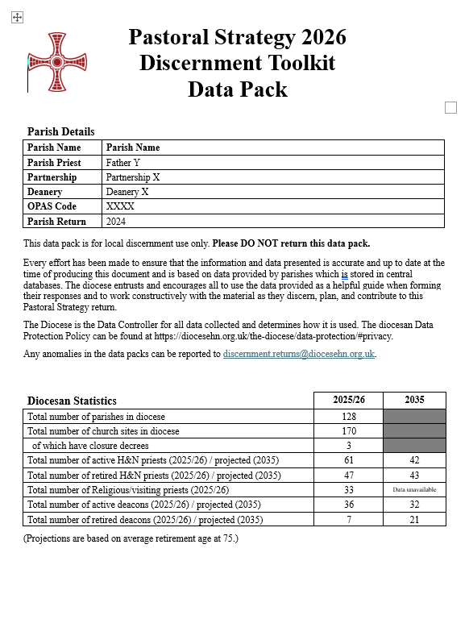
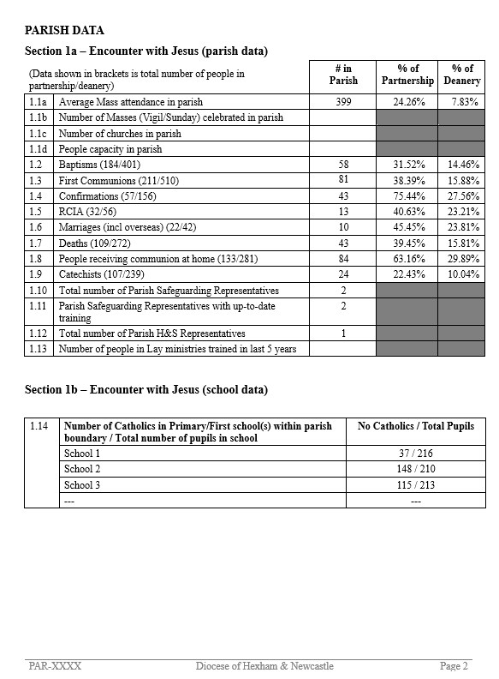
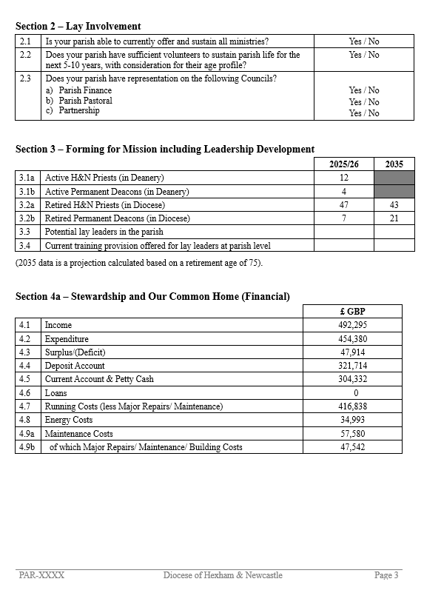
The Parish Data Pack
The Parish Data Pack includes
Parish details
Diocesan statistics
Parish data
School data
Lay involvement / Forming for mission
Financial data
Property data

Slide 40
The Parish Data Pack
How to request a copy of a parish data pack
Lay Volunteer / Parishioner >> Request via your parish priest
Parish Priest / Deacon >> Access via DHN SharePoint
Retired Clergy >> Request via your parish priest
If your Parish Priest is unavailable / unable to provide a copy, you can request it from your area Dean or email discernment.returns@diocesehn.org.uk

Slide 41

The Pastoral Planning Process
Parish Discernment
Diocesan Plan
Local Communities’ Synthesis
Councils & Consulters
Area Synthesis & Plans

Slide 42
Phase 1(Step A) Spring 2026
Parish discernment
Form H returned by 23rd April 2026
Phase 1(Step B) Local Communities (parishes/partnerships) discerning together
Form I returned by 4th June 2026
Phase 2 Summer 2026
Larger area (Deanery) synthesis Plans returned by 15 July 2026
Phase 3 Autumn 2026 Diocesan Pastoral Action Plan and begin implementation
The Pastoral Planning Process

Slide 43
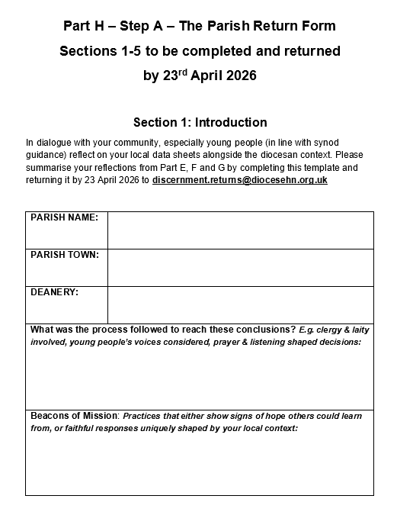
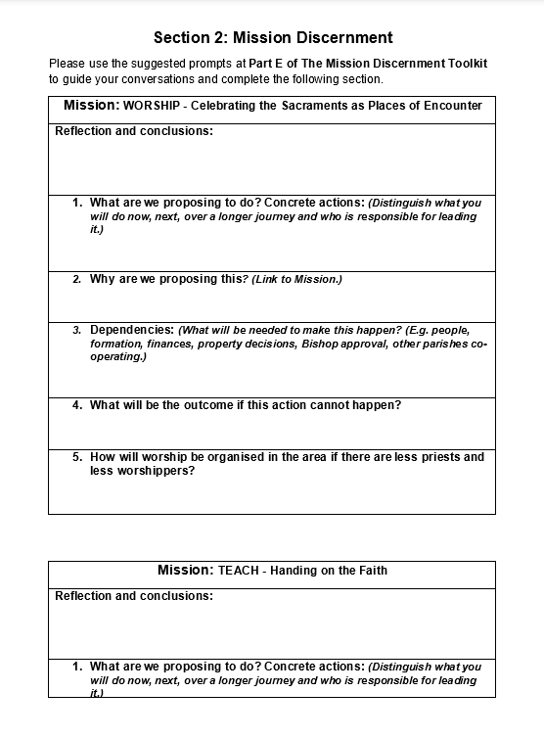
Continues Worship- Teach – Serve - Community

Slide 44
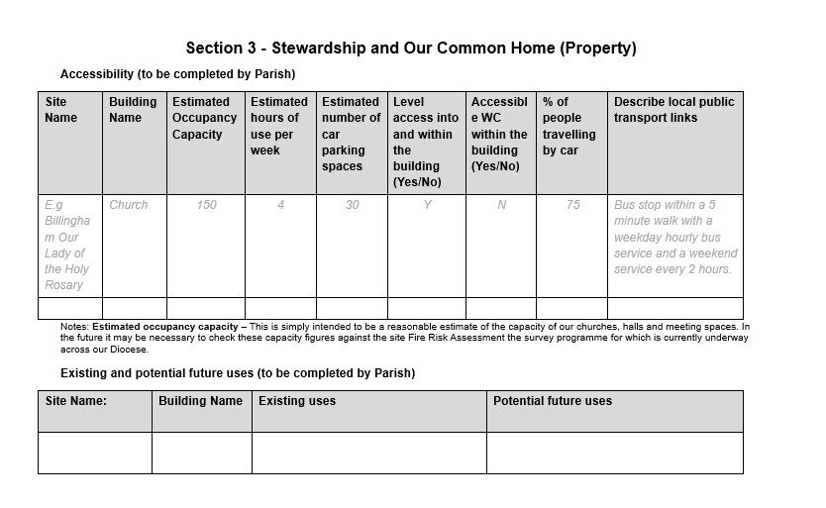

Slide 45
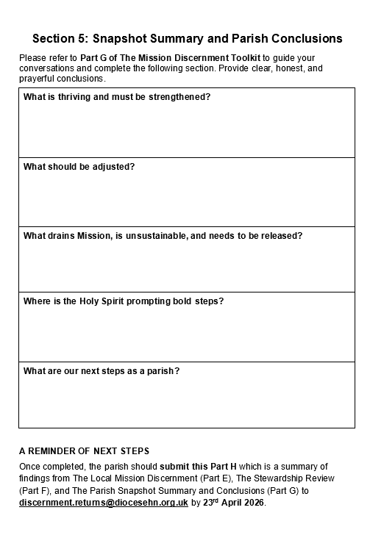
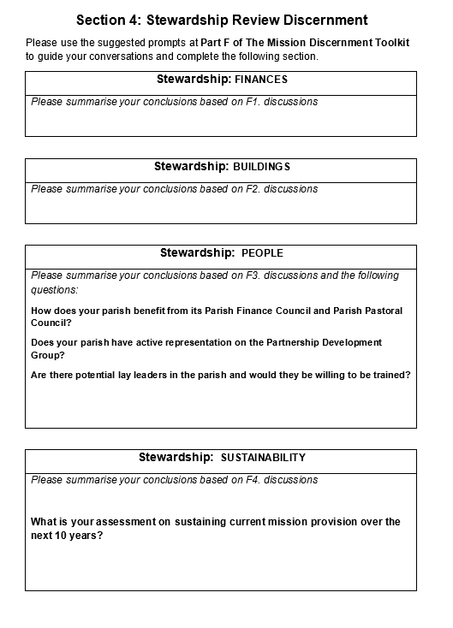

Slide 46
Next Steps
Local discernment in parishes by 23rd April – Spring 2026
Individual parishes’ outputs are synthesised into local community plans by 4th June and then Deanery level proposals – Summer 2026
The Bishop and Diocesan Trustees synthesise the Deanery proposals into a Diocesan Strategic Pastoral Strategy – Autumn / Winter 2026
Implementation – 2027 onwards
There will be an annual review cycle, gathering feedback, reviewing progress and making any necessary adjustments.

Slide 47
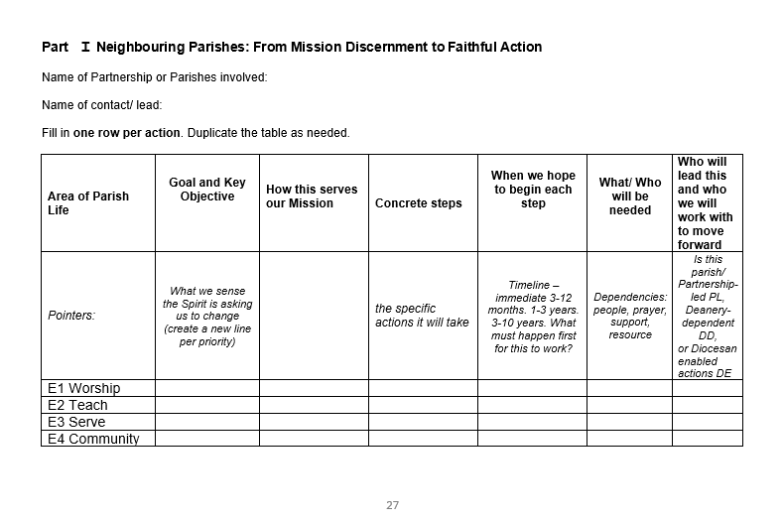
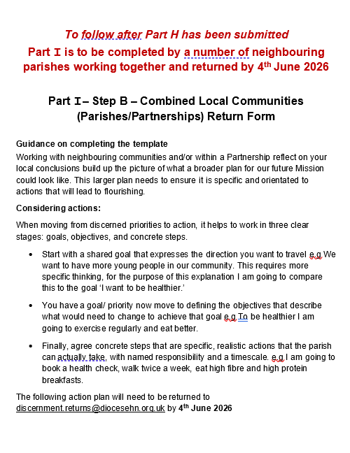
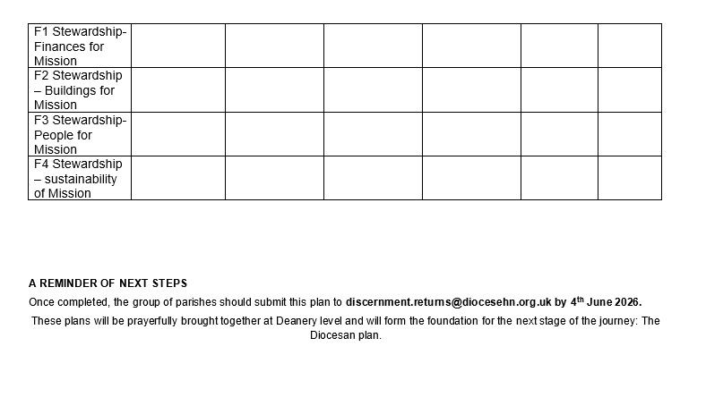
NOT YET

Slide 48
Support available
Diocesan Vision and Mission priorities in full
Discernment prayers
A guide to Catholic Terms
Suggested sessions on leading a conversation/ meeting around the toolkit
An invitation for school engagement
Facilitators to accompany the process

Slide 49
Who leads?
Who convenes? Parish Priest – Chair of Pastoral/ Parish Council
Who records? –nominated scribe/ minute taker
Who submits? –Parish Priest or delegated individual who copies in Parish Priest
Who facilitates prayer? – anyone but someone!
Who owns implementation? – The whole community

Slide 50
Thank you

